Slide 1

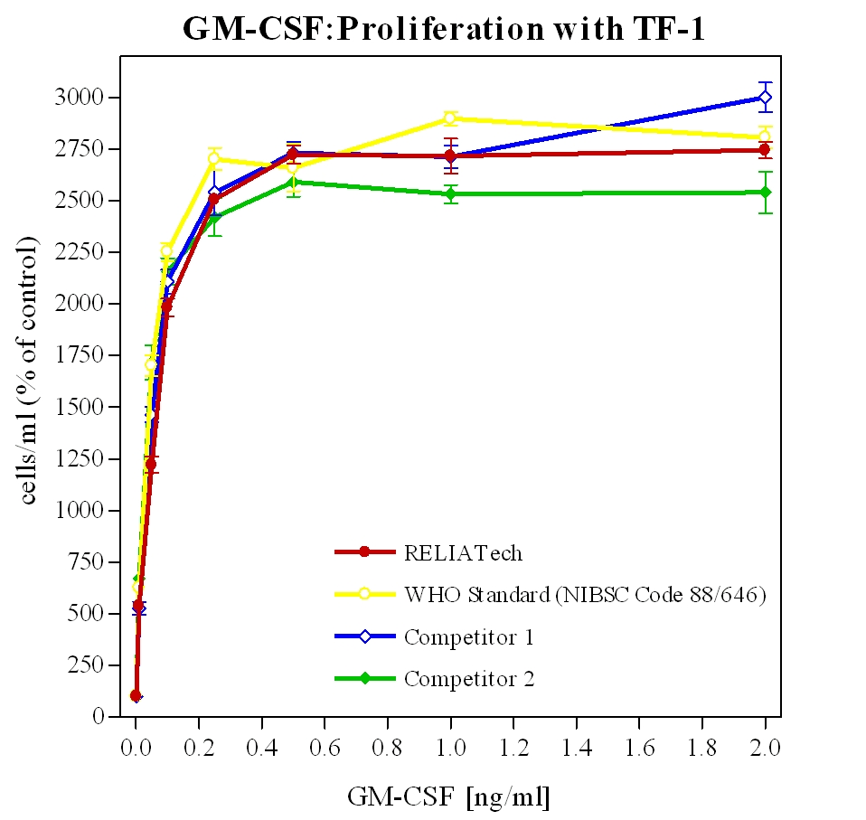
ReliaTech GmbH
Recombinant human GM-CSF
(Produced in E. coli; Cat# 200-004)
http://www.reliatech.de / orders@reliatech.de

